Slide 1


What is Fueling the Seattle Housing Market? April 12, 2021 Joanne Gates, John-Francis Kraemer, and Somya Panda
The Seattle Supersonic Housing Boom
For Discussion Purposes Only

Slide 2
What is Fueling the Seattle Housing Market?
Has anybody noticed how ridiculously expensive housing is in Seattle?
What specific Seattle neighborhoods and surrounding towns have experienced the greatest increase in housing prices in the past 10 years?
What are the underlying companies, asset types, and datapoints propelling the Seattle real estate market and this immense increase in wealth?
Is there a strong individual correlation between these datapoints and Seattle housing prices?
Is there a strong weighted index correlation of these datapoints and Seattle housing prices?
Can those datapoints be forecasted into the future?
Can housing prices in Seattle be forecasted based on the future performance of these datapoints?

Slide 3
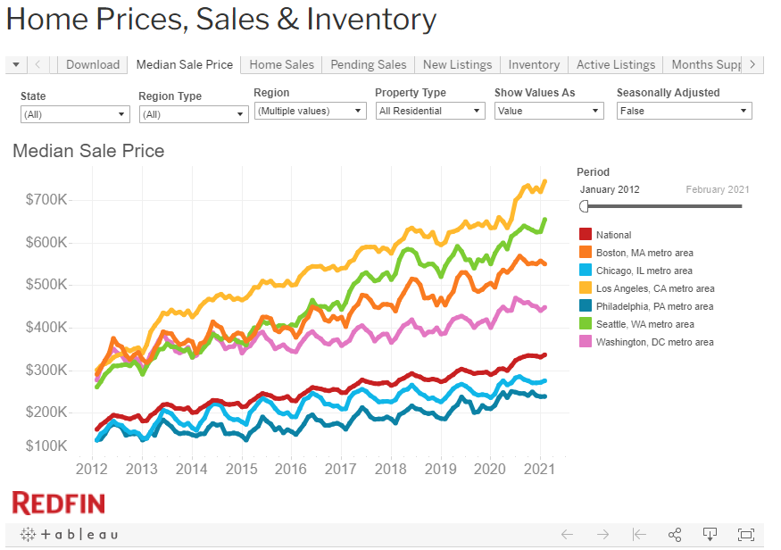
Seattle Housing Market – Housing Data
Researched historical housing prices of Seattle neighborhoods and surrounding metro area towns
Pulled historical prices over the past 9 years (2012) from RedFin (https://www.redfin.com/news/data-center/)

Slide 4
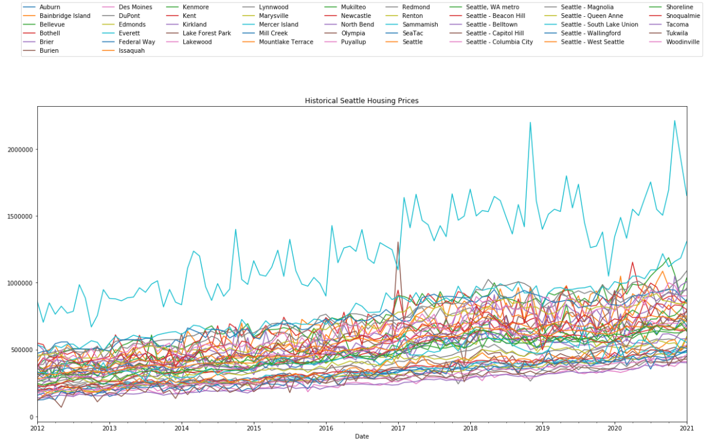
Seattle Housing Market – Housing Data
Seattle neighborhoods and metro area towns include the following:

Slide 5
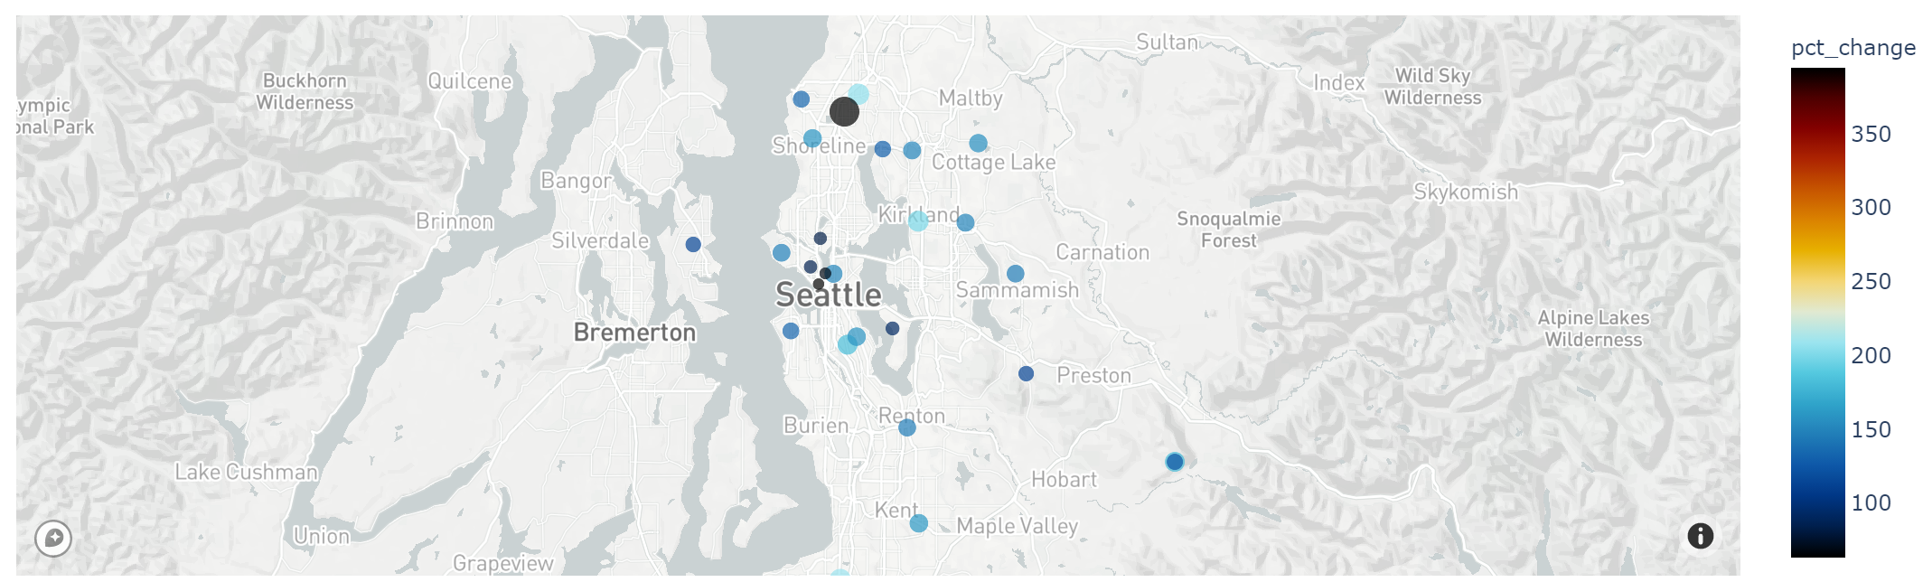
Seattle Housing Market – Housing Data
Historical changes in housing prices since February 2012

Slide 6
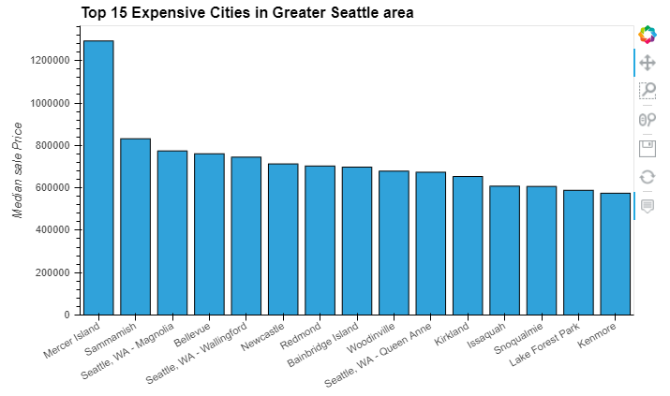
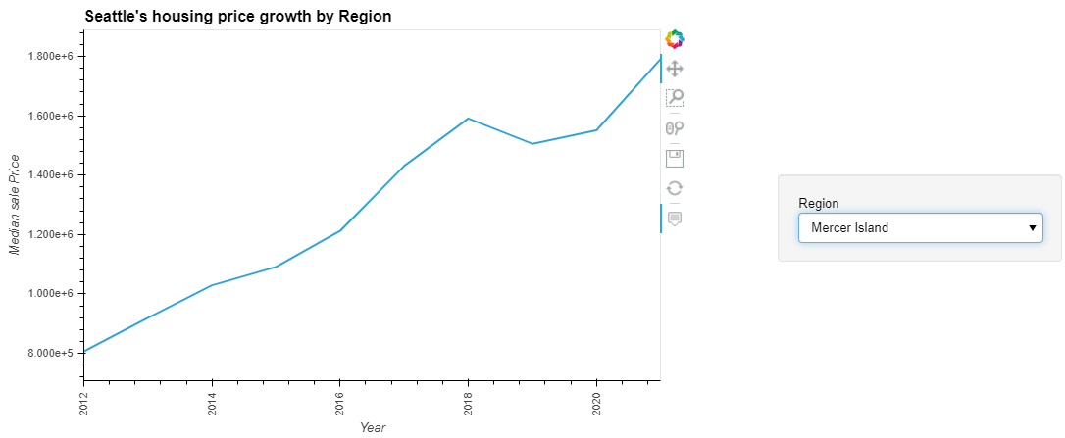
Seattle Housing Market – Housing Data

Slide 7
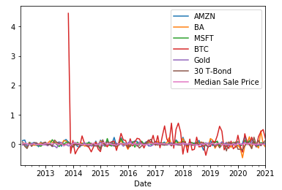
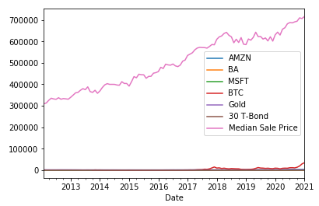
Seattle Housing Market – Assets/Datapoints
What are the underlying companies, asset types, and datapoints propelling the Seattle real estate market?
Researched largest publicly traded big tech employers in the Seattle area
Amazon, Boeing, Microsoft, Tableau, Zulily
Researched other asset classes
Gold, 30-year Treasury Bond Yields, Bitcoin
Pulled historical prices of those assets over the past 9 years and cleaned data
Used Alpaca, Coinbase, S&P Capital IQ, US Treasury

Slide 8
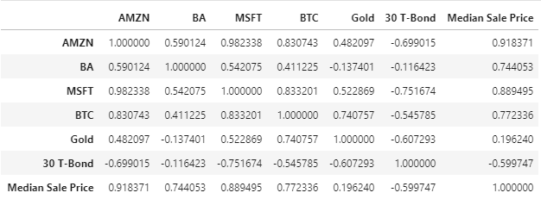
Seattle Housing Market – Correlation
Calculated individual correlation of 42 Seattle neighborhoods and surrounding town median housing prices by month over the past 9 years against the prices of Amazon, Microsoft, Boeing, Tableau, Zulily, Gold, Bitcoin, 30-year Treasuries
Identified the assets with the highest correlation to historical median housing prices
High correlation between median housing prices with AMZN (.92) and MSFT (.89)

Slide 9
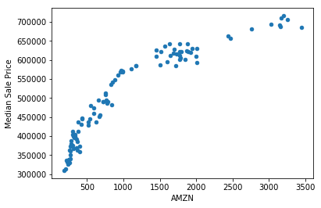
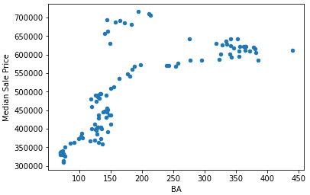
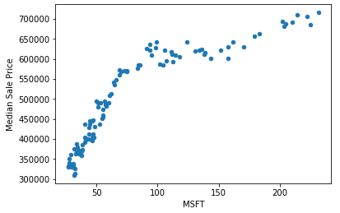
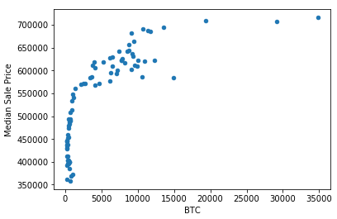
Seattle Housing Market – Correlation
Correlation charts of AMZN, BA, MSFT, and BTC against median housing prices

Slide 10
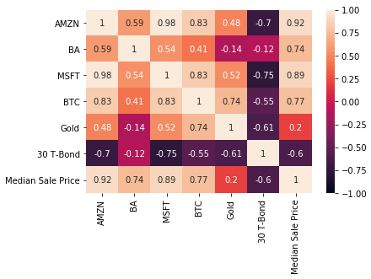
Seattle Housing Market – Correlation
High correlation between median housing prices with AMZN (.92) and MSFT (.89)

Slide 11
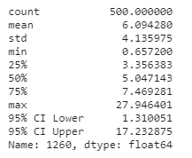
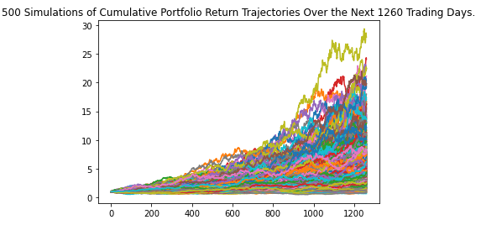
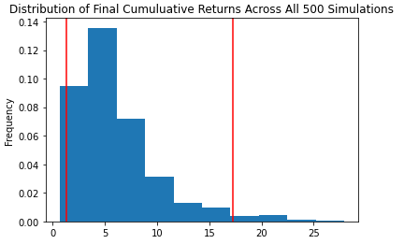
Seattle Housing Market – Monte Carlo Simulation
Ran a Monte Carlo Simulation on the future performance of AMZN stock
5-year projection with 500 iterations based on 3 years of historical AMZN stock data
Mean cumulative return of AMZN stock over 5 years is 609.4%
Implied stock price in 5 years is $23,923.33
$23,923.33 = $3,372.20 * (1 + 6.094)

Slide 12
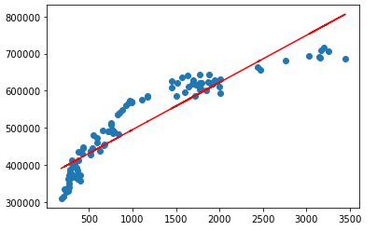
Seattle Housing Market – Linear Regression
Calculated linear regression on AMZN stock prices and median average Seattle housing prices
Imported new Panda libraries
from sklearn.linear_model import LinearRegression
import statsmodels.api as sm
Linear Regression Equation
y = m(x) + b
m = slope
b = intercept
x = AMZN stock price
y = Median housing prices
r² = coefficient of determination (correlation squared)¹
Note:
¹ The coefficient of determination is a statistical measurement that examines how differences in one variable can be explained by the difference in a second variable, when predicting the outcome of a given event

Slide 13
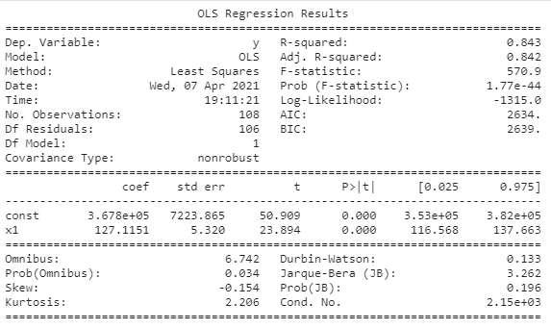
Seattle Housing Market – Linear Regression (Historical)
Linear Regression Equation
y = m(x) + b
m = 127.11
b = 367,756
x = $3,372.20 (AMZN close on 4/9/21)
y = Median housing prices (today)
r² = 0.84
y = 127.11 * 3,372.20 + 367,756
y = $796,414.42
Based on the linear regression methodology, the current estimated average median housing price in Seattle is $796,414
Actual average median house price is $715,974 (as of 2/28/21)

Slide 14
Seattle Housing Market – Linear Regression (Projected - 5 Years)
Linear Regression Equation
y = m(x) + b
m = 127.11
b = 367,756
x = $23,923.33 (AMZN in 5 years)
y = Median housing prices (in 5 years)
r² = 0.84
x = $3,372.20 (1 + 6.094)
AMZN 5-year stock price = $23,923.33
y = (127.11 * $23,923.33) + 367,756
y = $3,408,774.44
The estimated average median housing price in 5 years in Seattle is $3,408,774

Slide 15
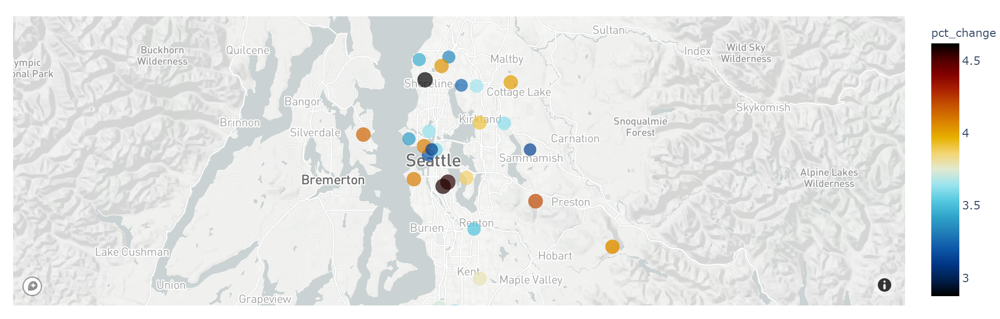
Seattle Housing Market – MapBox (Projected - 5 Years)
Projected change in housing prices over the next 5 years

Slide 16

Questions

Slide 17
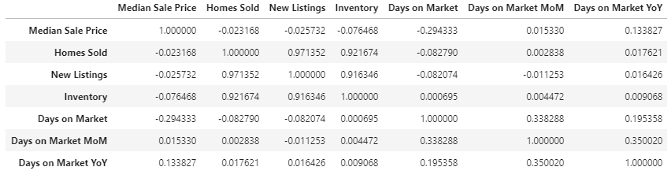
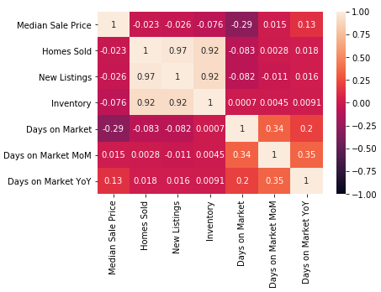
Appendix - Seattle Housing Market – Correlation
Addition housing metrics and correlation against median housing prices

Slide 18
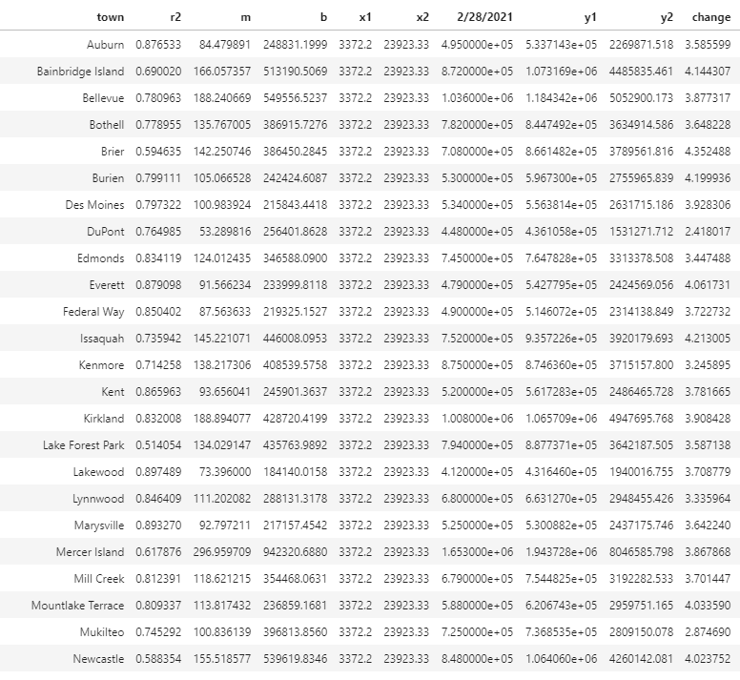
Appendix – Projected Housing Prices (5 Years)
Addition housing metrics and correlation against median housing prices

Slide 19
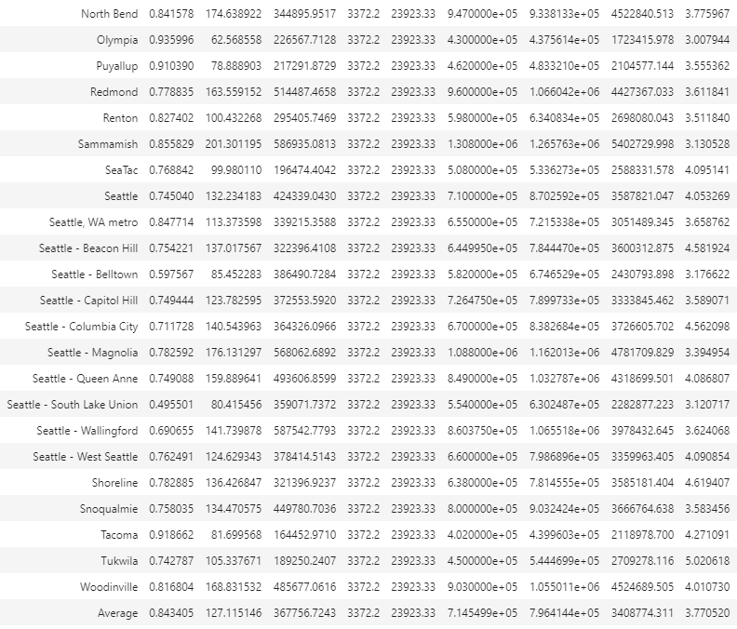
Appendix – Projected Housing Prices (5 Years)
Addition housing metrics and correlation against median housing prices

